Slide 1

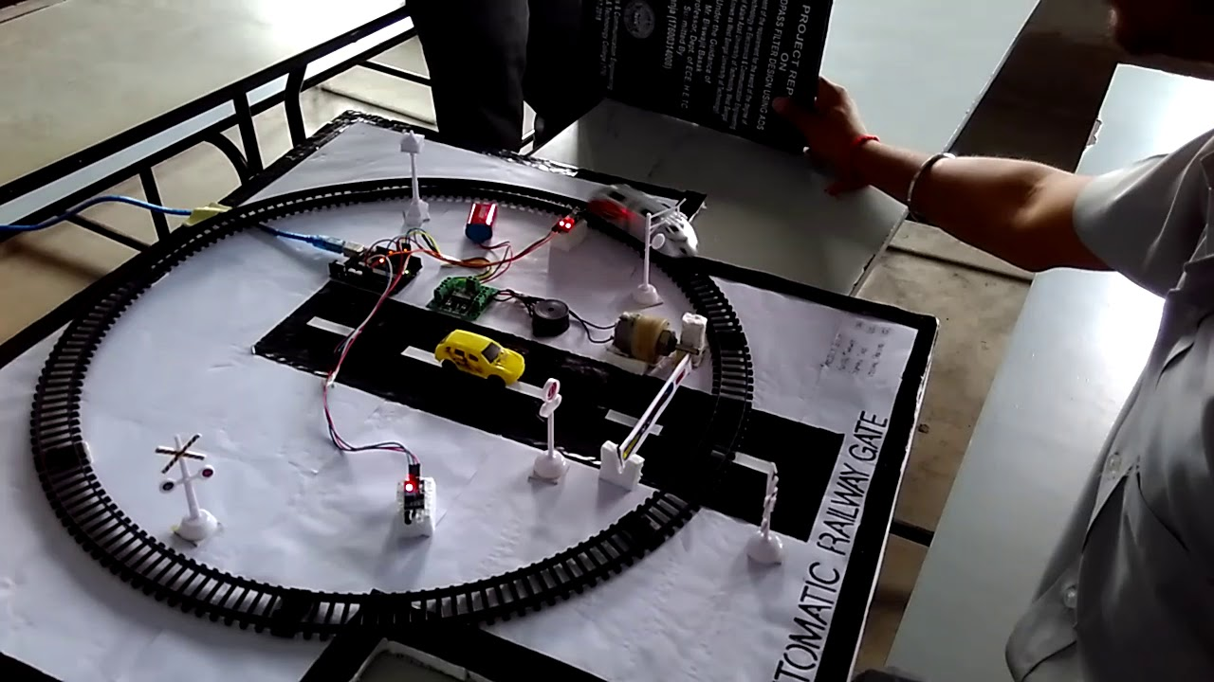
DAV INSTITUTE OF ENGINEERING AND TECHNOLOGY, PALAMU
Automatic Railway Gate Control System
B.Tech Final Year Project
Department of Electronics and Communication Engineering
Submitted By: Group ElectroMinds
Guided By: Mr. Deepak Sir
1
Notes:
Image source: https://i.ytimg.com

Slide 2

GROUP MEMBERS
Satyam Kumar (21020460010)
Kanchan Kumar (21020460006)
Bhart Bharti (21020460002)
Chanda Kumari (21020460003)
2
Notes:
Image source: https://i.ytimg.com

Slide 3

OUR ESTEEMED FACULTY MEMBERS
Mr. Deepak Sir
(HOD & Assistant Professor)
Mr. Suraj Sir
(Assistant Professor)
3
Notes:
Image source: https://i.ytimg.com

Slide 4
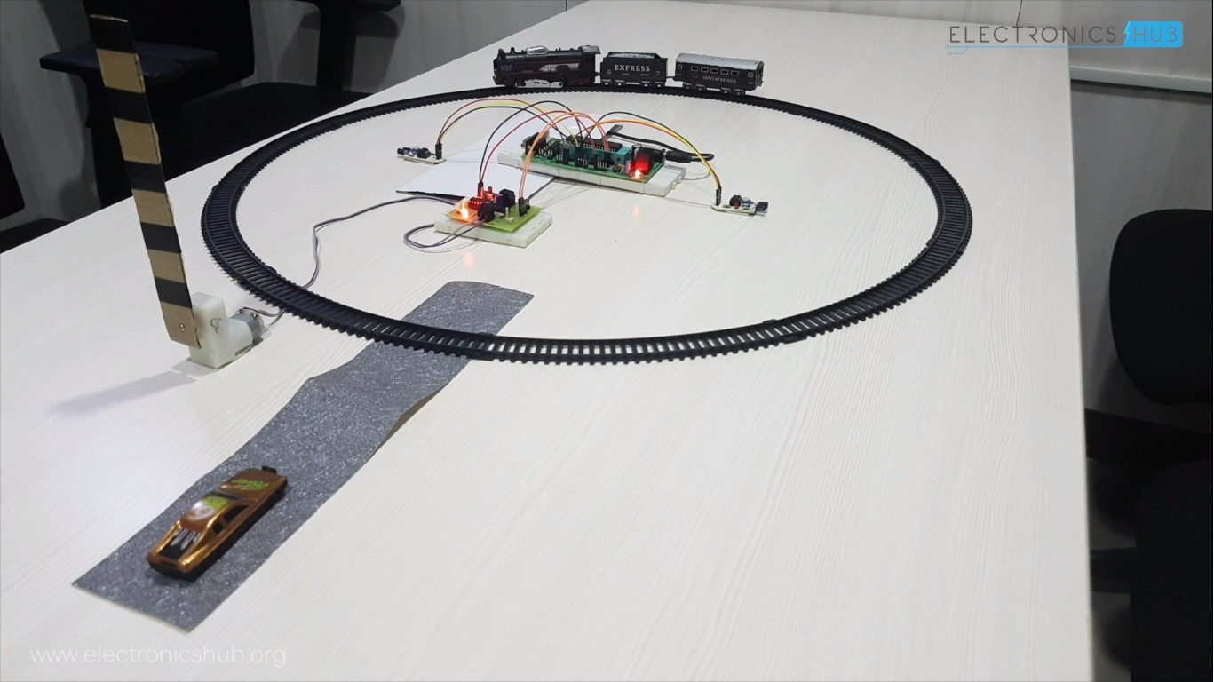
INTRODUCTION
Railway crossings are high-risk zones where safety is crucial.
Manual gate operations often lead to delays and accidents
To address this, our project presents a cost-effective, intelligent automated railway gate control system.
It uses ultrasonic sensors, Arduino, and servo motors to detect trains and control gate movements automatically, enhancing both safety and traffic flow at crossings.
4
Notes:
Image source: https://www.orr.gov.uk

Slide 5
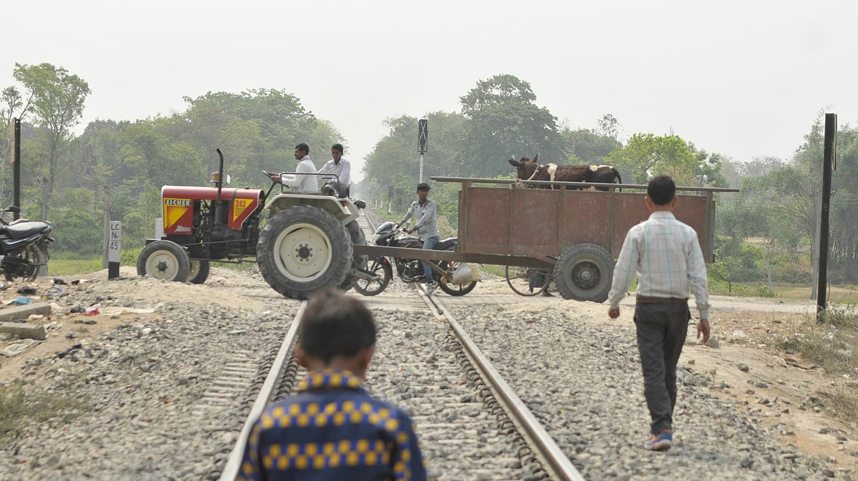
PROBLEM STATEMENT
Manual railway gate operations are still common, especially in rural and semi-urban areas.
These systems are prone to human error, delayed responses, and poor visibility, leading to accidents.
In 2024, India saw 40 train accidents and 313 passenger deaths (highest in a decade).
335 fatalities reported in ECR zone (Jan–Apr 2025) due to trespassing.
Existing automated systems are often costly and complex.
5
Notes:
Image source: https://document360.com

Slide 6

OBJECTIVES OF THE PROJECT
Develop an Arduino Uno-based automated gate control system for unmanned railway crossings.
Use ultrasonic sensors to detect train approach and departure with high accuracy.
Automate gate movement using servo motors to ensure timely closure and opening.
Integrate audio-visual alerts (buzzers, red/yellow/green LEDs) for public safety.
Design a cost-effective, scalable system for rural and semi-urban deployment.
6
Notes:
Image source: https://extrudesign.com

Slide 7
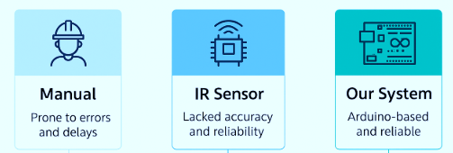
LITERATURE REVIEW
Previous systems used IR sensors or manual operations, which lacked accuracy and reliability.
Research highlights microcontroller-based automation, but many setups were costly or complex.
Ultrasonic sensors proved more effective for train detection.
Existing models lacked real-time alerts and scalability.
Our system bridges this gap using Arduino, ultrasonic sensors, servo motors, and audio-visual signals for a low-cost, reliable solution.
7
Notes:
Image source: https://www.mdpi.com

Slide 8
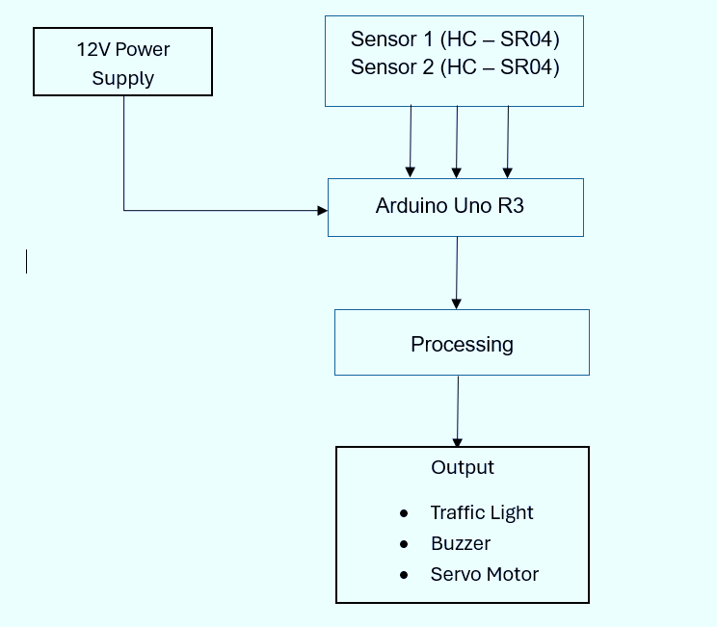
SYSTEM ARCHITECTURE OVERVIEW
The system is powered by a 12V supply and uses two ultrasonic sensors (HC-SR04) to detect the train's approach and departure.
These inputs are processed by an Arduino Uno R3, which acts as the control unit.
Based on sensor data, the Arduino triggers outputs including a traffic light module, buzzer, and servo motors to automatically manage gate operation and safety alerts.
8
Notes:
Image source: https://www.interviewbit.com

Slide 9
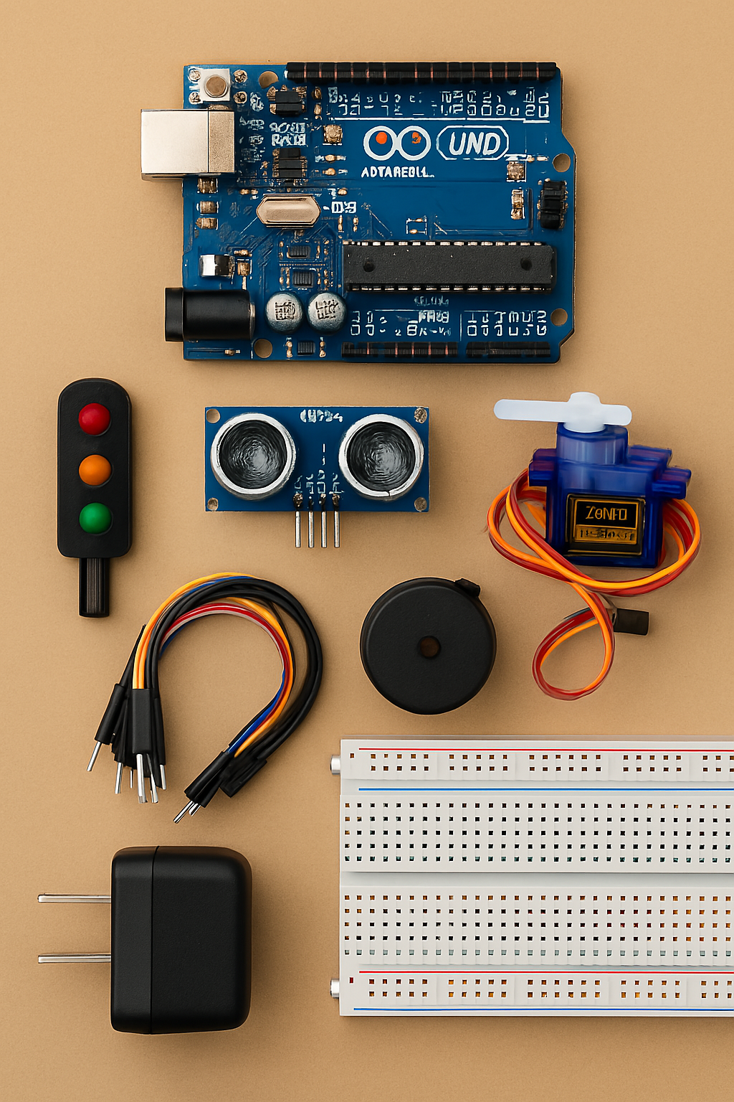
COMPONENTS USED
Arduino Uno R3 – Main microcontroller for processing sensor inputs and controlling outputs.
Ultrasonic Sensors (HC-SR04) – Detect approaching and departing trains.
Servo Motors (SG90) – Open and close the railway gate automatically.
Traffic Light LED Module – Signals red, yellow, or green based on train status.
Buzzer – Provides audio alerts for nearby vehicles and pedestrians.
Power Supply (12V Adapter) – Powers the entire circuit.
Jumper Wires & Breadboard – For circuit connections and prototyping.
9
Notes:
Image source: https://www.researchgate.net

Slide 10
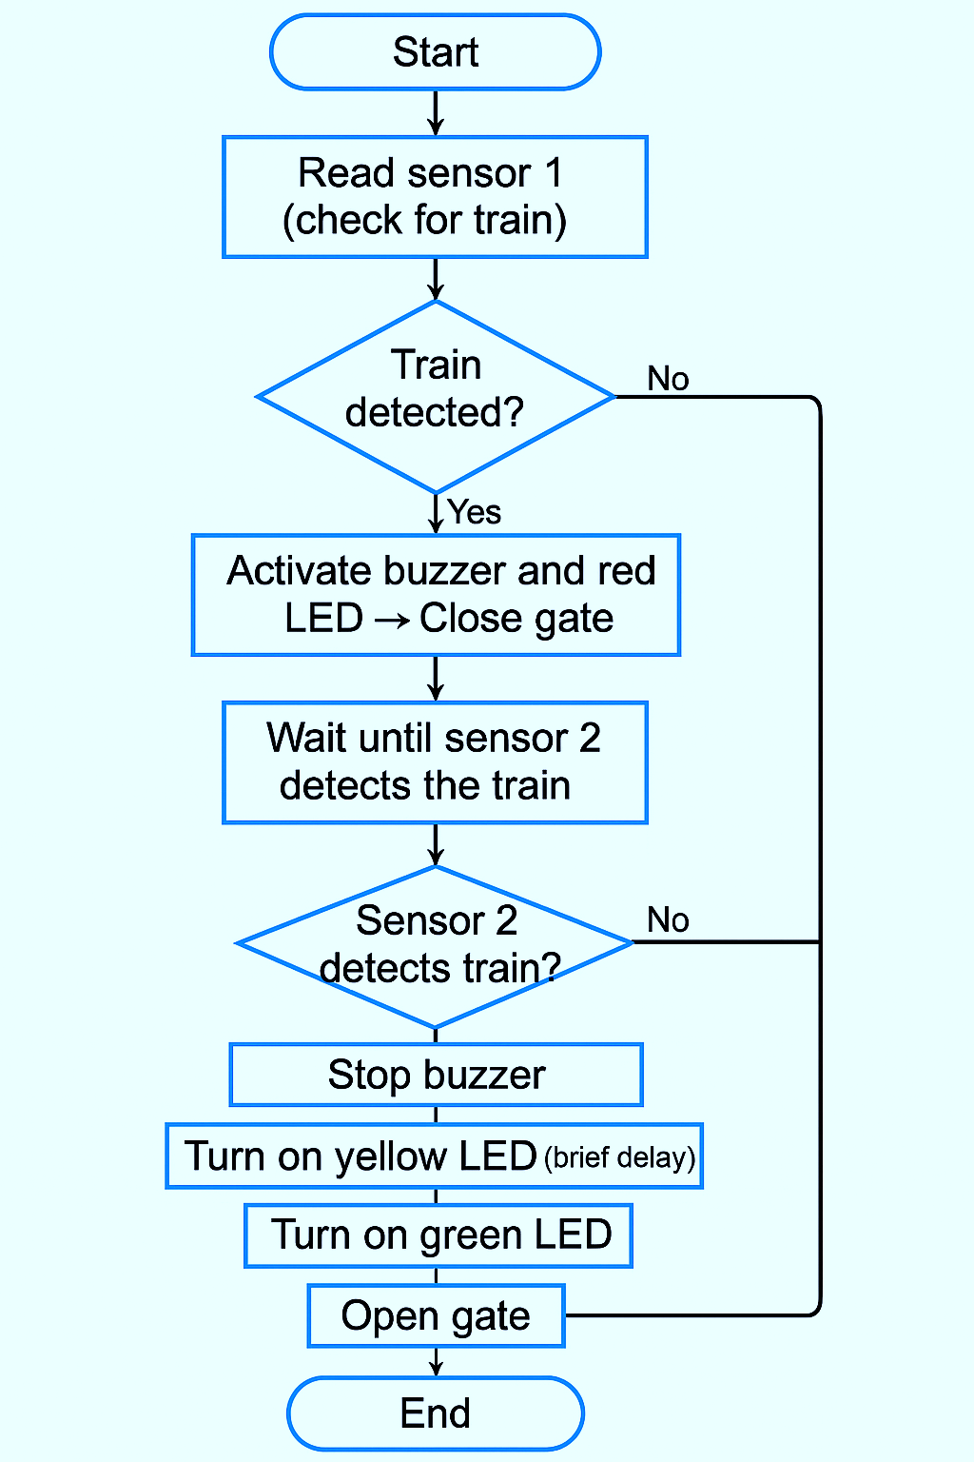
WORKING MECHANISM
Train Detection: Ultrasonic sensors detect the train's presence at a predefined distance.
Signal Processing: Sensor data is sent to the Arduino Uno, which processes the input.
Gate Control: The Arduino triggers servo motors to close the gate when the train is near and reopen it once the train passes.
Alerts: Traffic lights and a buzzer activate to warn pedestrians and vehicles during gate operation.
9
Notes:
Image source: https://altpro.com

Slide 11
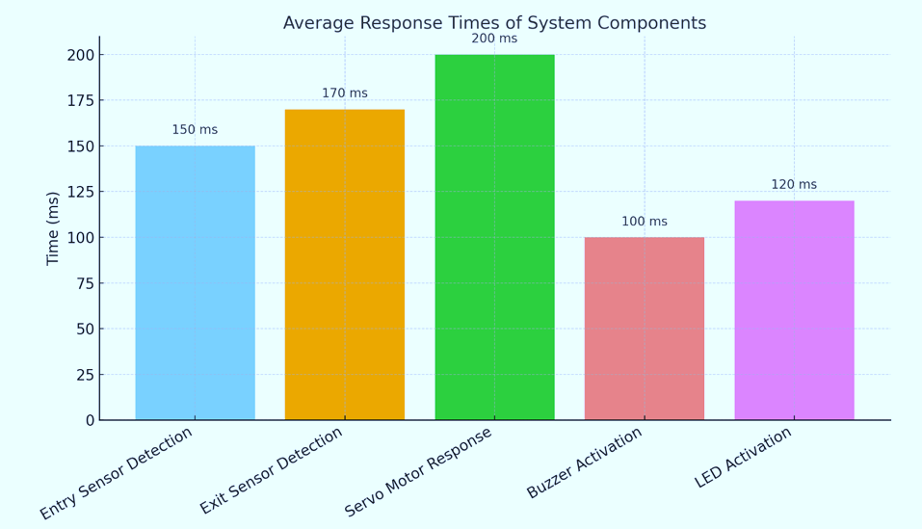
TESTING AND RESULTS
The system responded within seconds to train detection.
Gate opened and closed smoothly, synchronized with train movement.
No false triggers or missed detections were recorded.
Audio-Visuals alerts activated correctly during each text.
Performance remained stable in repeated trails under varying conditions.
Average Response for the system was 150ms.
11
Notes:
Image source: https://d3i71xaburhd42.cloudfront.net

Slide 12

BENEFITS OF PROPOSED SOLUTION
Enhances safety by automating railway gate operations.
Minimizes human error and manual dependency.
Provides timely gate control with real-time train detection.
Incorporates audio-visual alerts for public awareness.
Cost-effective and suitable for rural and semi-urban crossings.
12
Notes:
Image source: https://www.slidemake.com

Slide 13

CHALLENGES FACED
Sensor calibration was essential for reliable train detection.
Unstable power supply initially caused inconsistent performance.
Component integration needed careful planning to avoid timing issues.
Servo motor angle had to be fine-tuned for smooth gate movement.
Managing wire connections was challenging in the compact setup.
13
Notes:
Image source: https://www.elprocus.com

Slide 14
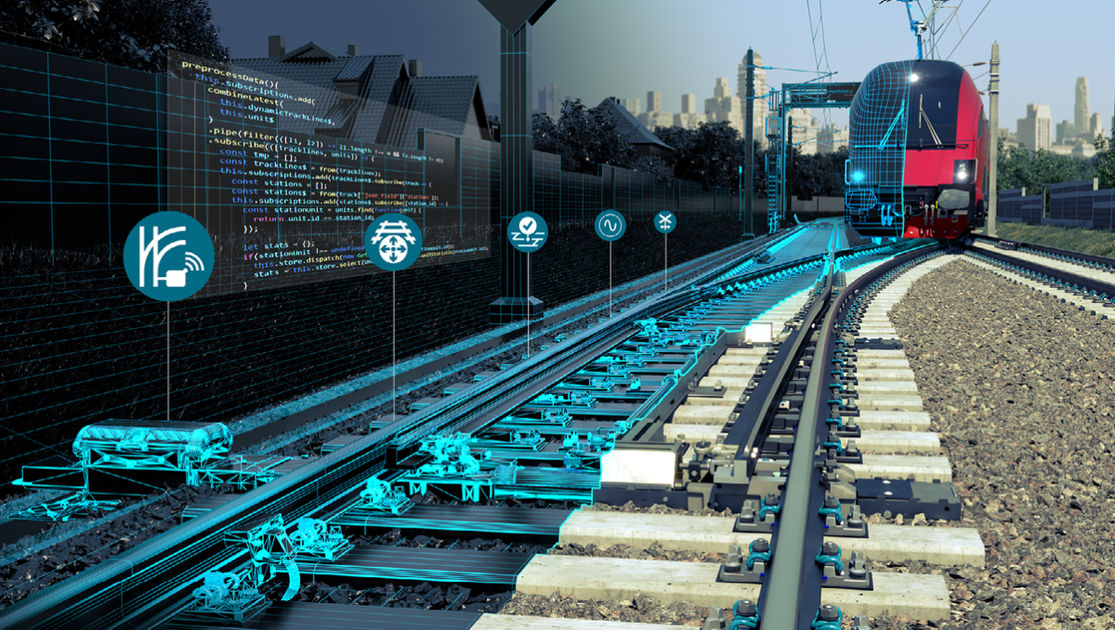
FUTURE SCOPE
Integrate wireless communication (e.g., GSM, IoT) for remote monitoring.
Connect with existing railway signaling systems for better coordination.
Use advanced sensors like LIDAR for precise and long-range train detection.
Implement solar-powered operation for energy efficiency in remote areas.
Add AI-based anomaly detection to enhance system intelligence and safety.
14
Notes:
Image source: https://www.voestalpine.com

Slide 15

CONCLUSION
Successfully implemented an automated railway gate control system.
Demonstrated accurate train detection using ultrasonic sensors.
Automated gate operation reduced reliance on manual control.
Improved safety and traffic management at crossings.
Future enhancements can increase scalability and robustness.
15
Notes:
Image source: https://i.ytimg.com

Slide 16
THANK YOU!
16
Notes:
Image source: https://i.ytimg.com

